Slide 1
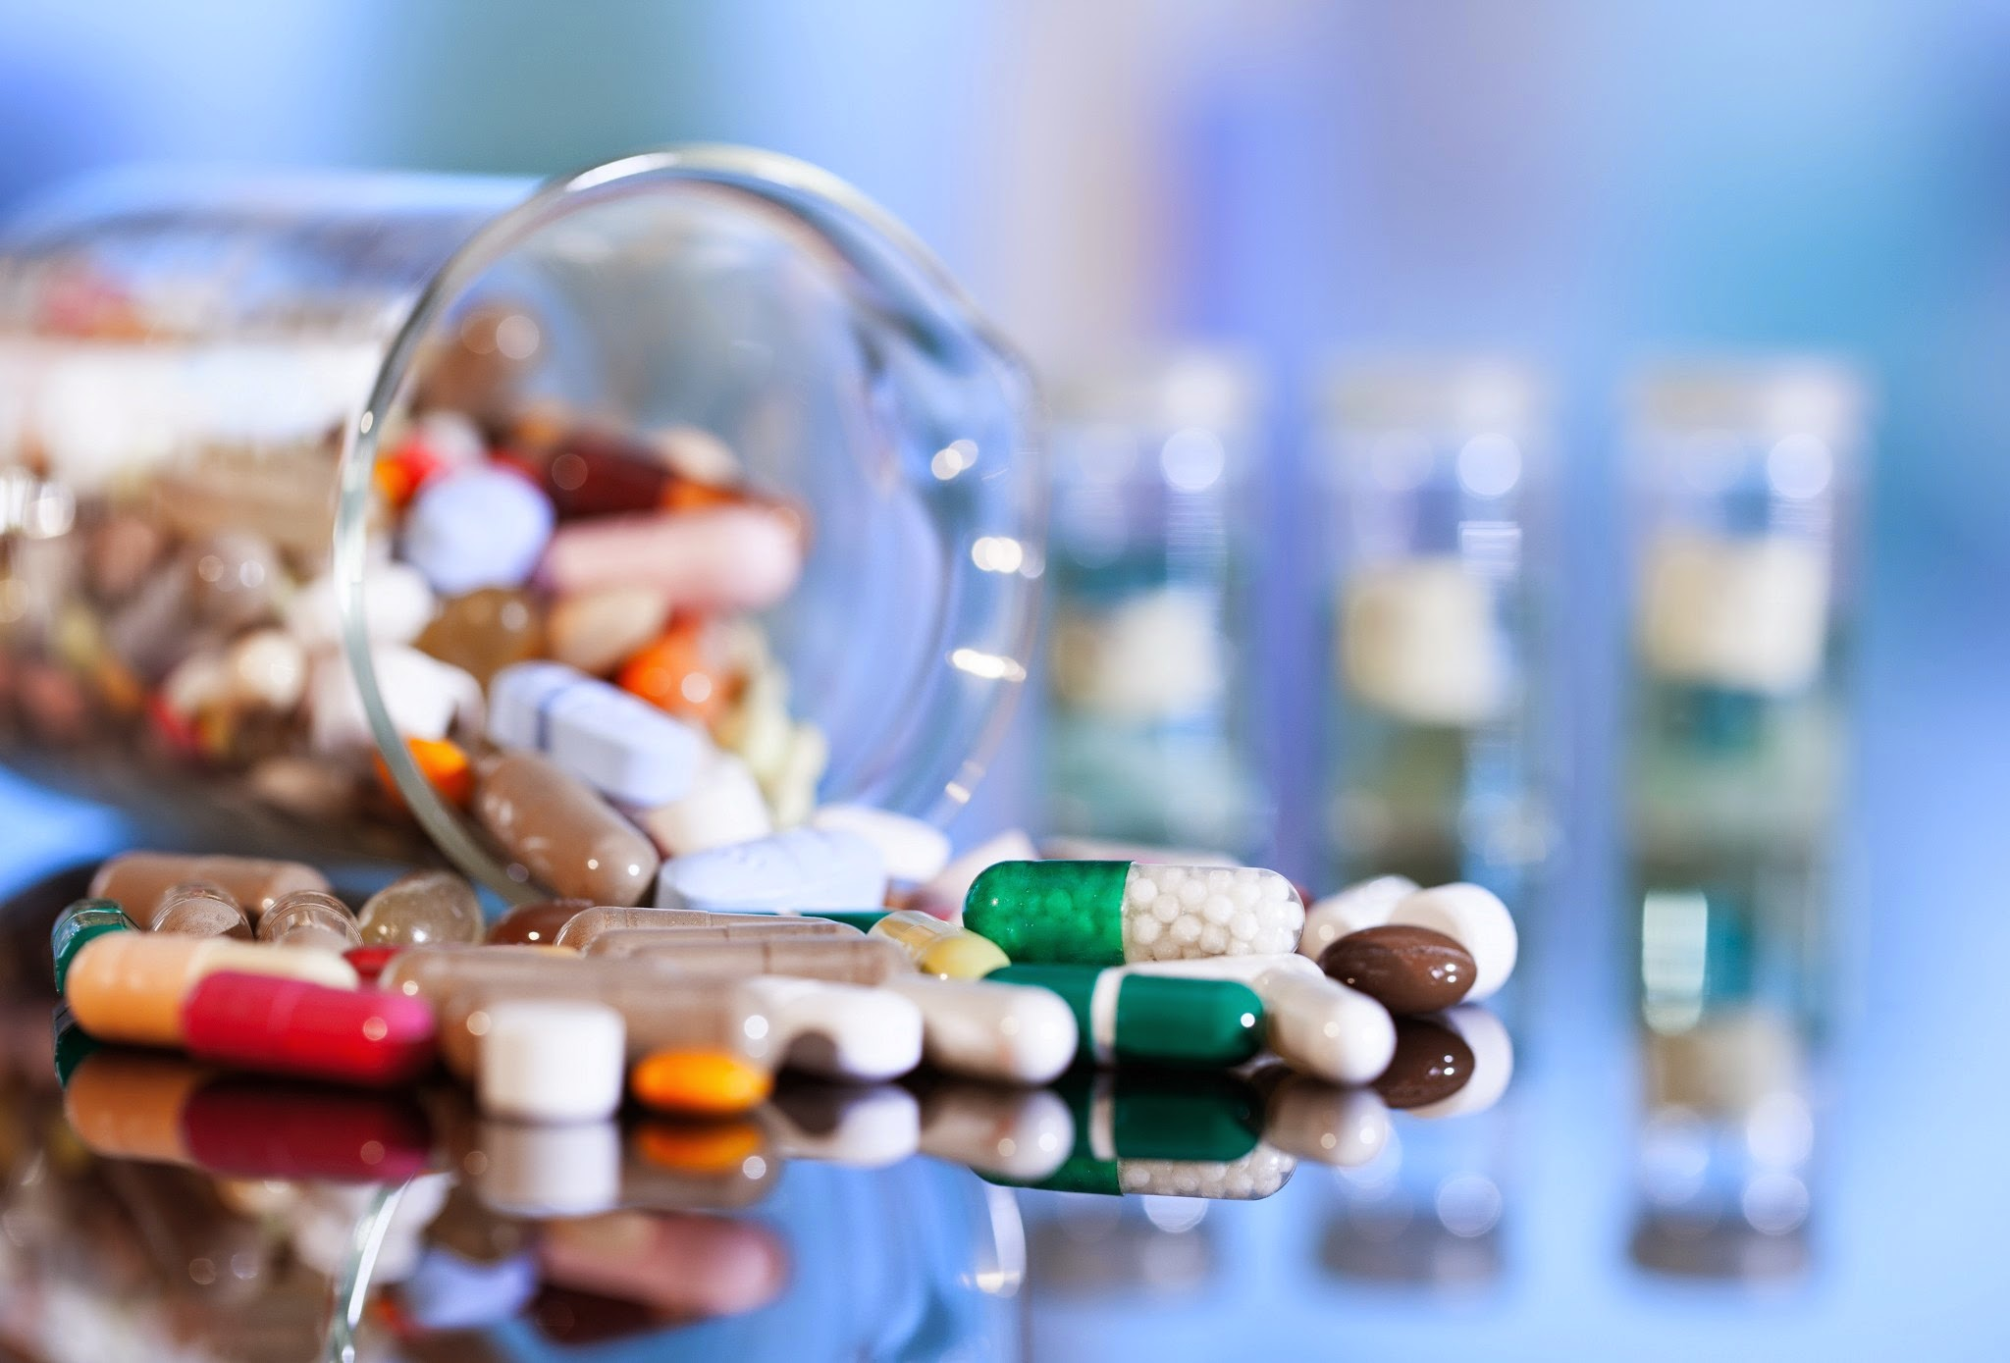
Predicting Clinical Trial Success
Pharma AI Team
Sheri Shojaie
Vivianti Santosa
Momotaz Mahin Khan
Eben Haezer Saputra

Slide 2
Clinical Trials are risky and expensive investment
Phase 3
$20M
Phase 2
$4M
86 %
Overall Failure Rate of drugs and vaccine trial
Phase 1
$4M
Clinical Trial Cost of drugs and vaccine trial
Notes:
Cost source: https://www.sofpromed.com/how-much-does-a-clinical-trial-cost/#:~:text=The%20average%20cost%20of%20phase,median%20of%20%2441%2C117%20per%20patient.
Failure rate: https://www.acsh.org/news/2020/06/11/clinical-trial-success-rates-phase-and-therapeutic-area-14845

Slide 3
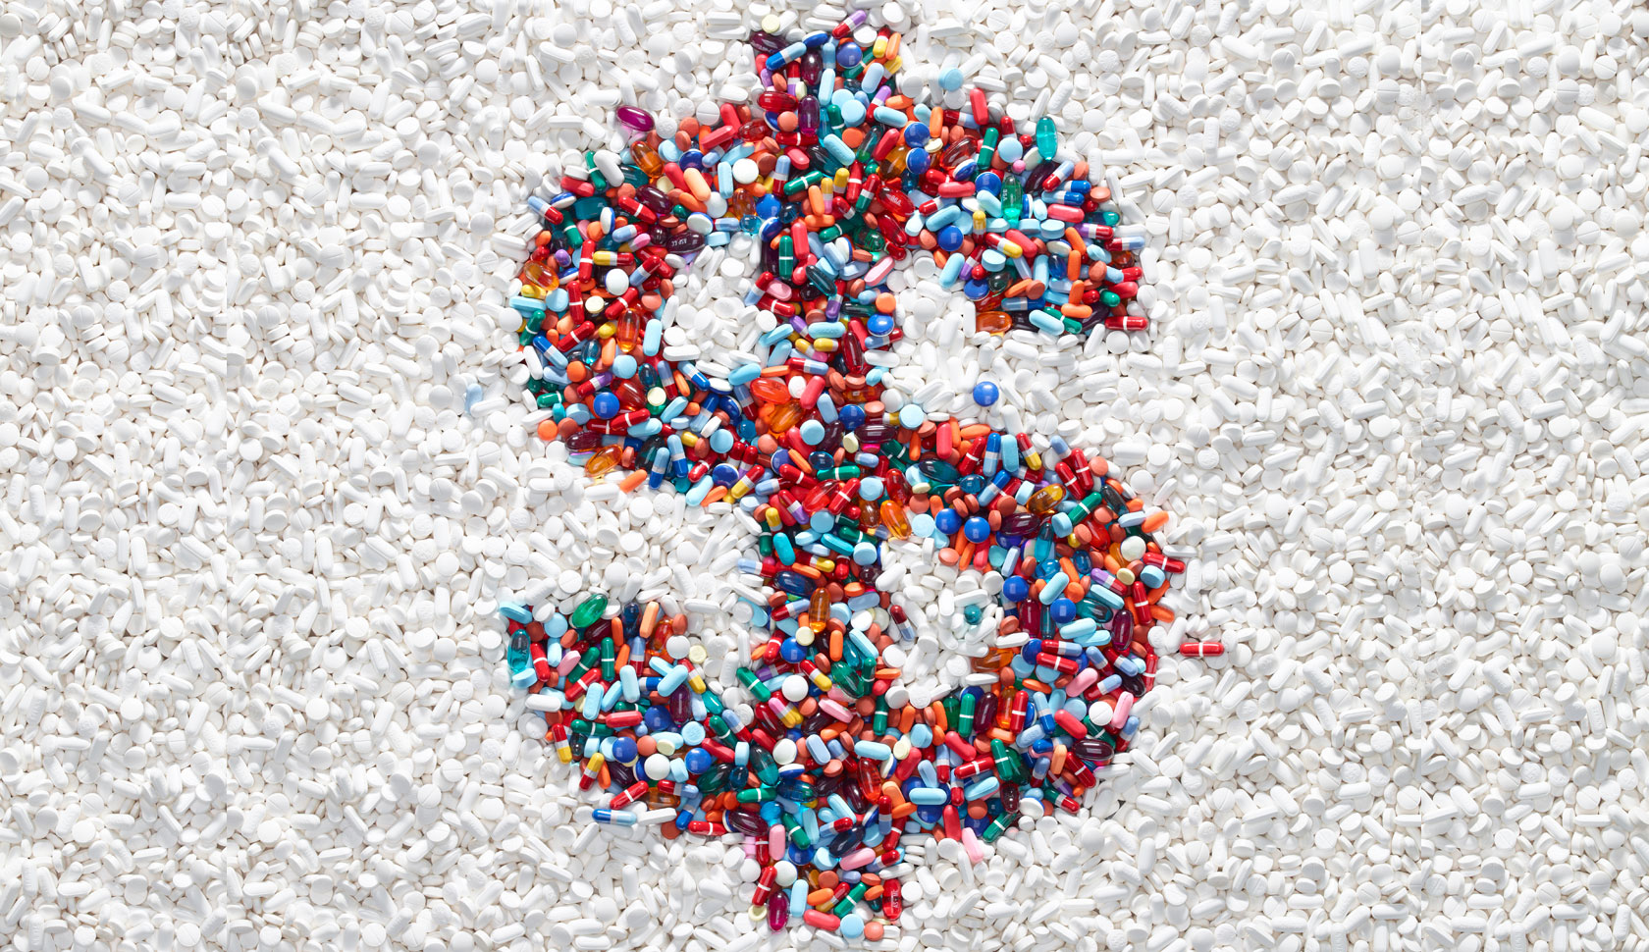
This causes exorbitant medicine cost
Annual drug prescription can be $200,000 - $500,00
Jacks up cost of healthcare
It is not curative

Slide 4
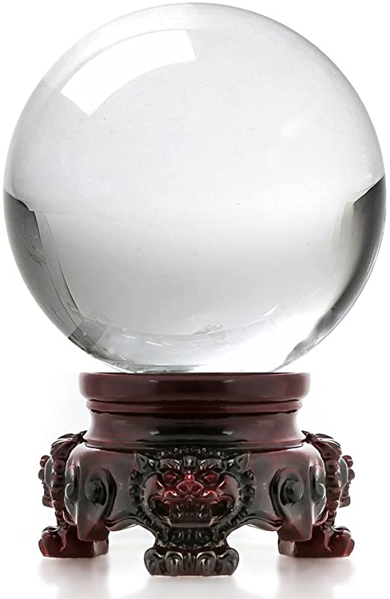
But what if we…
…can predict which trial more likely to succeed?
… can find factors that affect clinical trial success rate?

Slide 5

Enter Machine Learning!

Slide 6
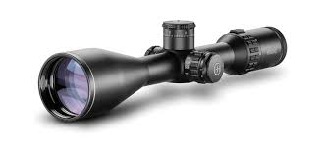
The process: 1. Scoping
Predicting success rate in Phase 2 only
Trials in United States only
Only features approved by Domain Knowledge Expert
Limited Text Parsing

Slide 7
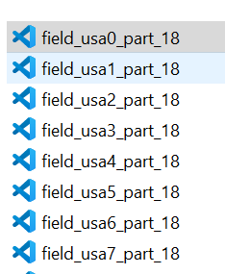
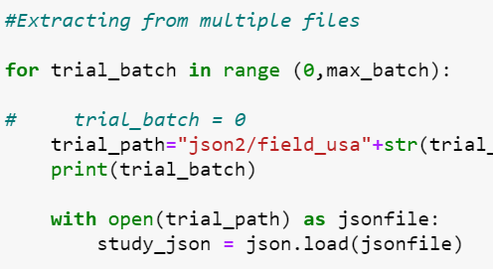
The process: 2. Data Extraction & Cleaning
API Extraction
Split to 18 batches
Auto Merging JSON
Out of 4GB of files

Slide 8
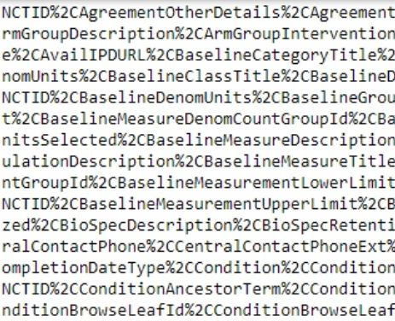
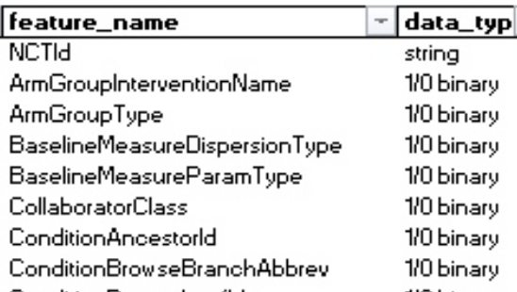
The process: 3. Data Storage and Pull
API Extraction
140k trials to analyze
Mostly Categorical Data
Hot Encoding Needed

Slide 9
Let’s see

